Slide 1
Natives of New Mexico
Pueblo, Navajo, and Apache
Tribes

Slide 2
Pueblo Indians
Lived in adobe Pueblos
All spoke different language
Common language Athasbaskan
Both move around
Both hunt big game
Concerns with the dead
Curing ceremonies
Farmers
Sedentary
Made hand crafted items:
Pottery, baskets, clothing, blankets, jewelry
Gathered
Polytheistic
Learn to make crafts
Hunt large game sometimes
Centered around religion
Traded
Hunted small game
(Eventually learn to farm)
Both made baskets
Navajo Tribe
Lived in Hogans
Semi-Nomadic
Apache Tribe
Lived in a Wickiup / Teepee
Hunted only large game
Nomadic

Slide 3
Pueblo People
Lived in Adobe Pueblos
Farmed
Hunted Small Game
Sometimes big game
Sedentary
Made hand crafts
Life centered around religion

Slide 4
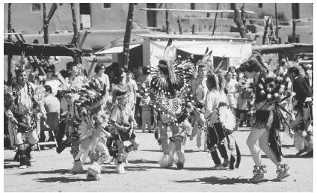

Slide 5
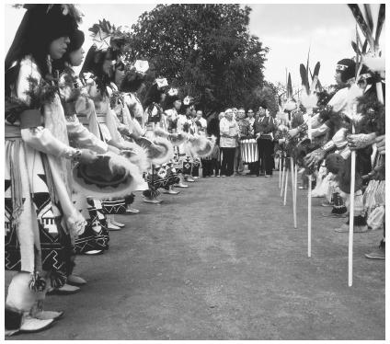

Slide 6
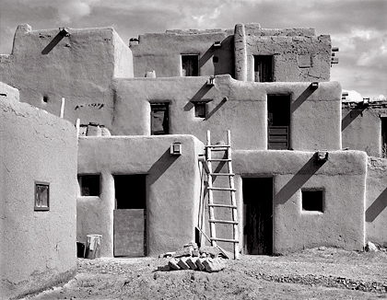

Slide 7
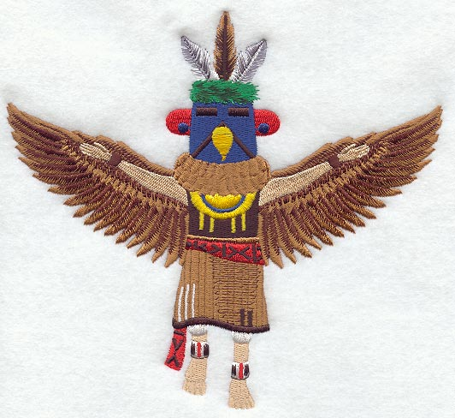
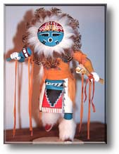

Slide 8
Navajo
Lived in a Winter and a Summer Hogan
Hunted Small and big game
Gathered
Raided at first
Eventually learn to farm
Religion center of their life
Semi-Nomadic
Largest reservation

Slide 10
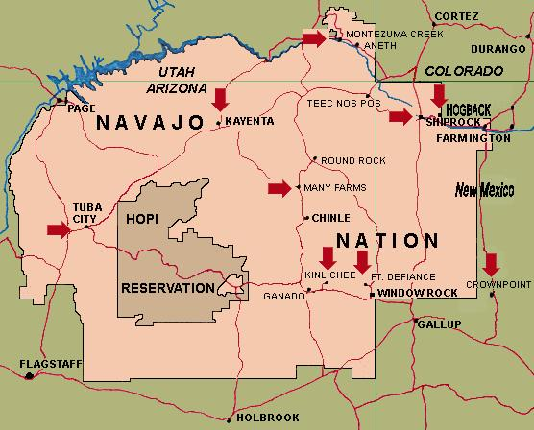

Slide 11
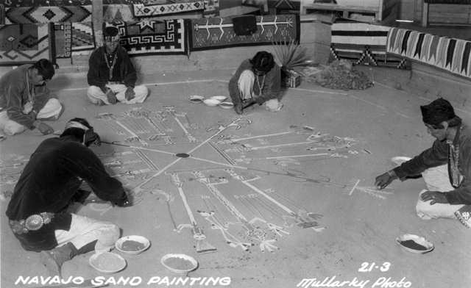

Slide 12
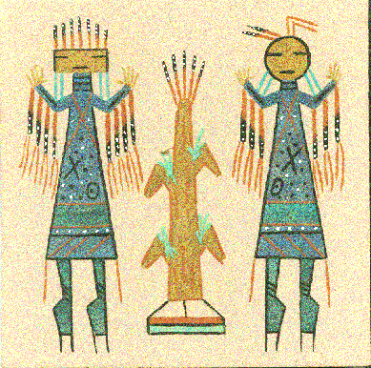

Slide 13
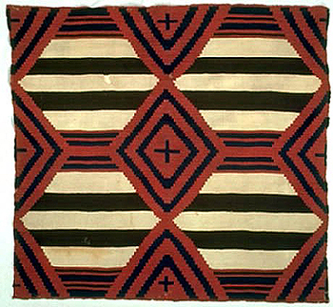

Slide 14
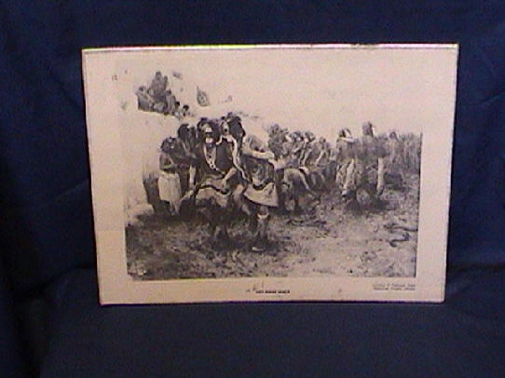

Slide 15
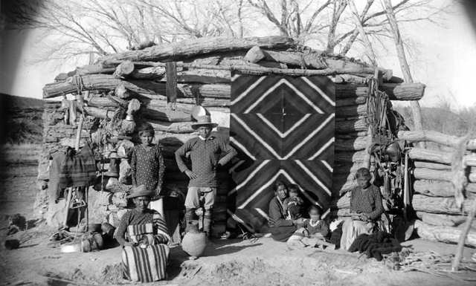

Slide 16
Apache
Lived in a tipi or a wickiup
Hunted big game
Raided
Made baskets
Had ceremonies
Concerned for the dead
Had the four mountain gods

Slide 17
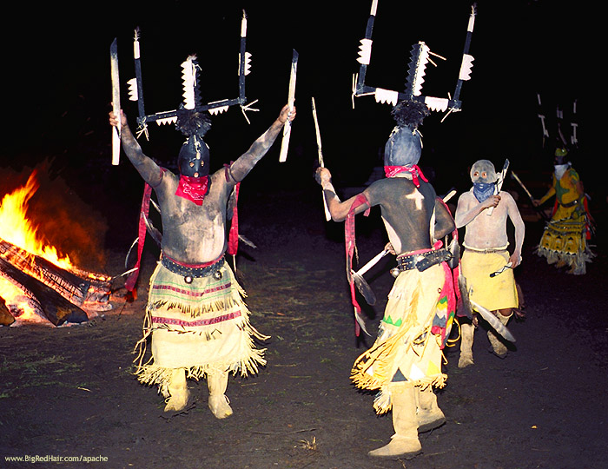

Slide 18
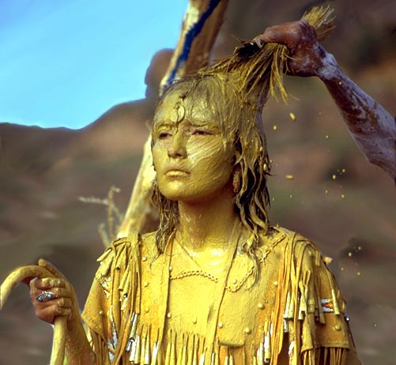

Slide 19
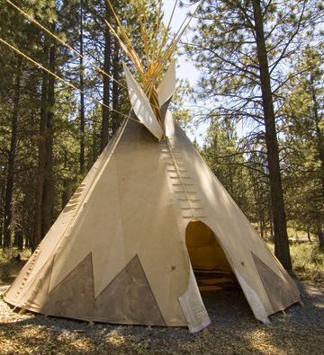

Slide 20
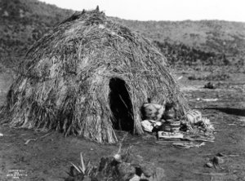

Slide 21
Six Tribes: three in NM
Chiricahua (most war like called Gila by Spainards)
Jicarilla (lived as hunters and gathers in NW NM)
Mescalero (known for eating the agave plant)

Slide 22
